Slide 1
HNDIT1104: Data Representation and Organization
Negative numbers representation
Part - 4
Lesson 10

Slide 2
Learning Objectives
At the end of the lesson student should be able to
  Add 2 ‘s complement numbers
  Identify the overflow.

Slide 3
Using The 2’s Compliment Process
Use the 2’s complement process to add together the following numbers.
POS
+ POS
POS
9
+ 5
14
NEG
+ POS
NEG
(-9)
+ 5
- 4
⇒
⇒
POS
+ NEG
POS
9
+ (-5)
4
NEG
+ NEG
NEG
(-9)
+ (-5)
- 14
⇒
⇒
Notes:
This slide show that there are only four possible combinations for adding together two signed numbers. The next four slides demonstrate each of these examples.

Slide 4
POS + POS → POS Answer
If no 2’s complement is needed, use regular binary addition.
9
+ 5
14
⎯→
00001001
00000101
⎯→
+
←⎯
00001110
Notes:
Addition of two Positive numbers.

Slide 5
POS + NEG → POS Answer
Take the 2’s complement of the negative number and use regular binary addition.
9
+ (-5)
4
⎯→
00001001
11111011
+
←⎯
1]00000100
8th Bit = 0: Answer is Positive
Disregard 9th Bit
00000101
↓↓↓↓↓↓↓↓
11111010
+1
11111011
2’s
Complement
Process
Notes:
This example shows the addition of one positive and one negative numbers. Note that this is done in the same way as subtracting a positive number from a positive number. In this case, the answer is positive.

Slide 6
POS + NEG → NEG Answer
Take the 2’s complement of the negative number and use regular binary addition.
(-9)
+ 5
-4
11110111
00000101
⎯→
+
←⎯
11111100
8th Bit = 1: Answer is Negative
11111100
↓↓↓↓↓↓↓↓
00000011
+1
00000100
00001001
↓↓↓↓↓↓↓↓
11110110
+1
11110111
To Check:
Perform 2’s
Complement
On Answer
2’s
Complement
Process
Notes:
This slide demonstrates the addition of one positive and one negative number. Again, this is is the same a subtracting a positive number from a positive number. In this case the answer happens to be negative.

Slide 7
NEG + NEG → NEG Answer
Take the 2’s complement of both negative numbers and use regular binary addition.
(-9)
+ (-5)
-14
⎯→
11110111
2’s Complement
Numbers, See
Conversion Process
In Previous Slides
11111011
⎯→
+
←⎯
1]11110010
8th Bit = 1: Answer is Negative
Disregard 9th Bit
11110010
↓↓↓↓↓↓↓↓
00001101
+1
00001110
To Check:
Perform 2’s
Complement
On Answer
Notes:
This slide demonstrates the addition of two negative numbers.

Slide 8
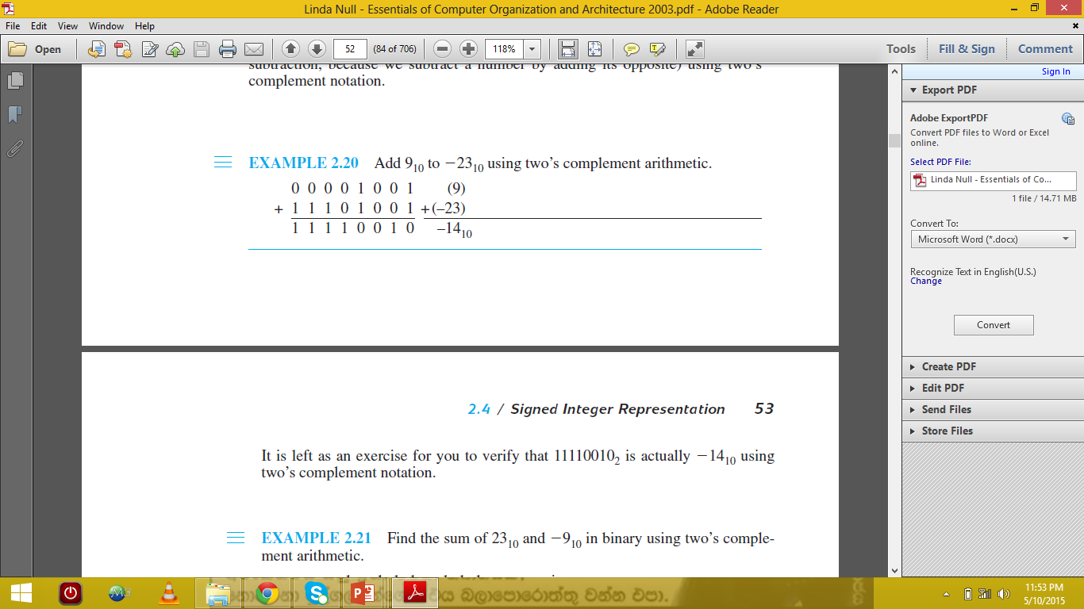

Slide 9
Overflow
An overflow occurs if two positive numbers are added and the result is negative,
or if two negative numbers are added and the result is positive.
It is not possible to have overflow when using two’s complement notation if a positive and a negative number are being added together.

Slide 10
A Simple Rule for Detecting an Overflow Condition
If the carry into the sign bit equals the carry out of the bit, no overflow has occurred.
If the carry into the sign bit is different from the carry out of the sign bit, overflow (and thus an error) has occurred.

Slide 11
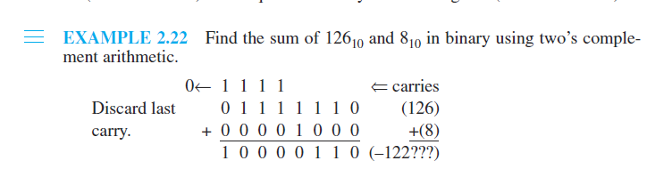
Example 2.22 indicates overflow because the carry into the sign bit (a 1 is carried in) is not equal to the carry out of the sign bit (a 0 is carried out).
A one is carried into the leftmost bit, but a zero is carried out. Because these carries are not equal, an overflow has occurred. (We can easily see that two positive numbers are being added but the result is negative.)

Slide 12
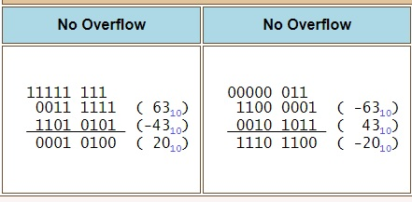
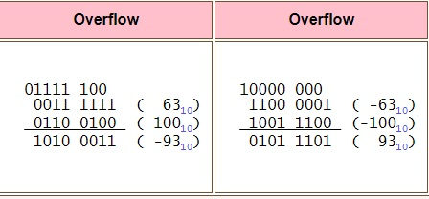

Slide 13
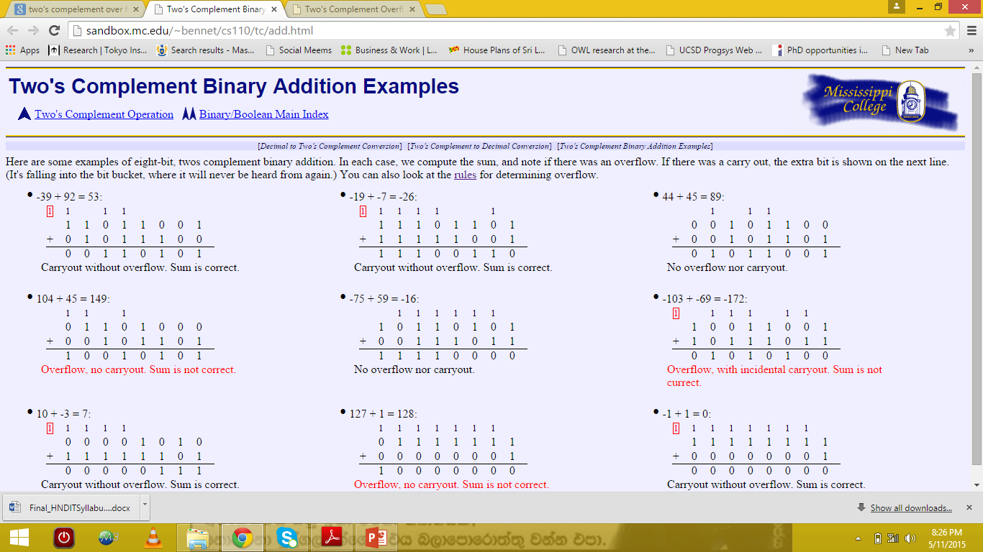

Slide 15
v

